Slide 1
Courageous People Project
Brittany Brown, Kirstin Lakeberg, Nance Adler

Slide 2
Centropa Summer Academy, Poland, 2015

Slide 3
Courageous People Project: Guiding Questions
What is moral courage?
What must one do to act in a courageous way?
What is a moral compass, and how can we develop and strengthen our own?

Slide 4
Courageous People Project: Goals and Outcomes
Familiarize students with the idea of moral courage
Examine people from the past and present who have exhibited moral courage
Build high-level thinking skills through research and critical reasoning
Develop global awareness, perspective and citizenship through cross cultural exchanges
Increase empathy and understanding of the one’s moral compass

Slide 5
Courageous People Project: Lesson Overview
As a class, create a working definition of moral courage.
View a variety of images of people well-known for their moral courage.
- Discuss common threads
Watch one (or more) Centropa film(s).
- While viewing, students will note examples of moral courage, as well as questions, comments and powerful statements. Discuss as a class.

Slide 6
Courageous People Project: Lesson Overview
Final research project:
- Students will research a courageous person and create a digital poster encapsulating their findings. Focus on guiding questions and goals from this project.
The posters will be sent to other participating schools.
Gallery walks are an effective way to display and learn from the courageous people posters!

Slide 7
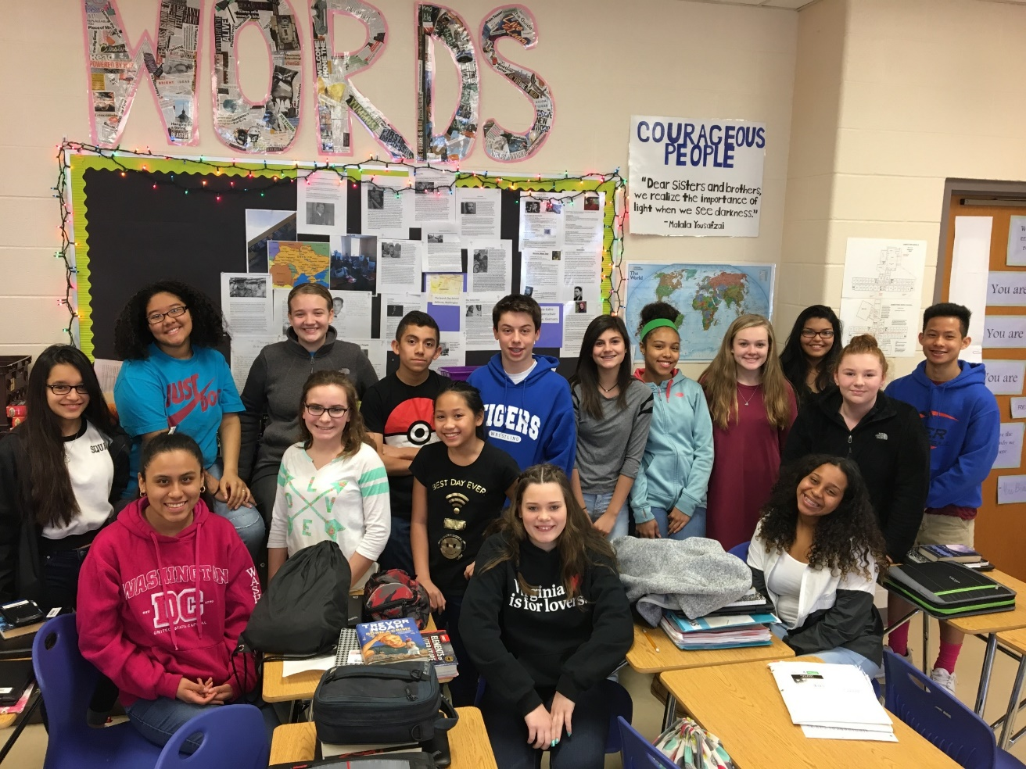
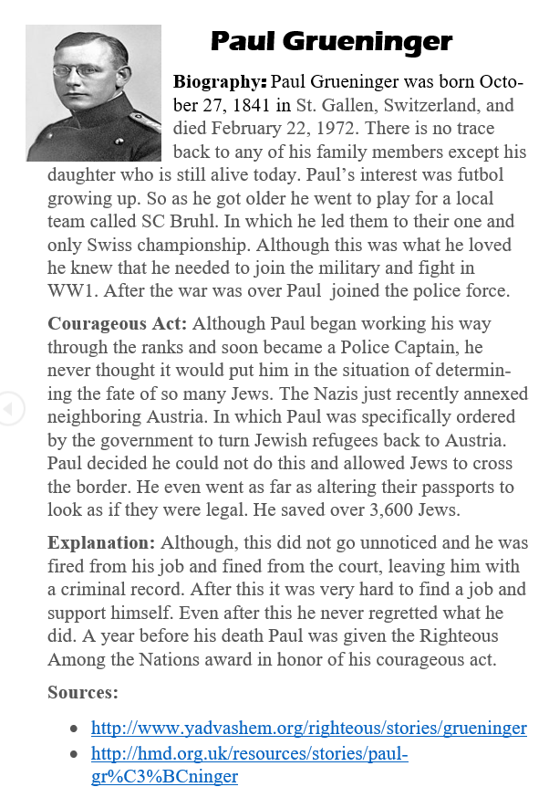
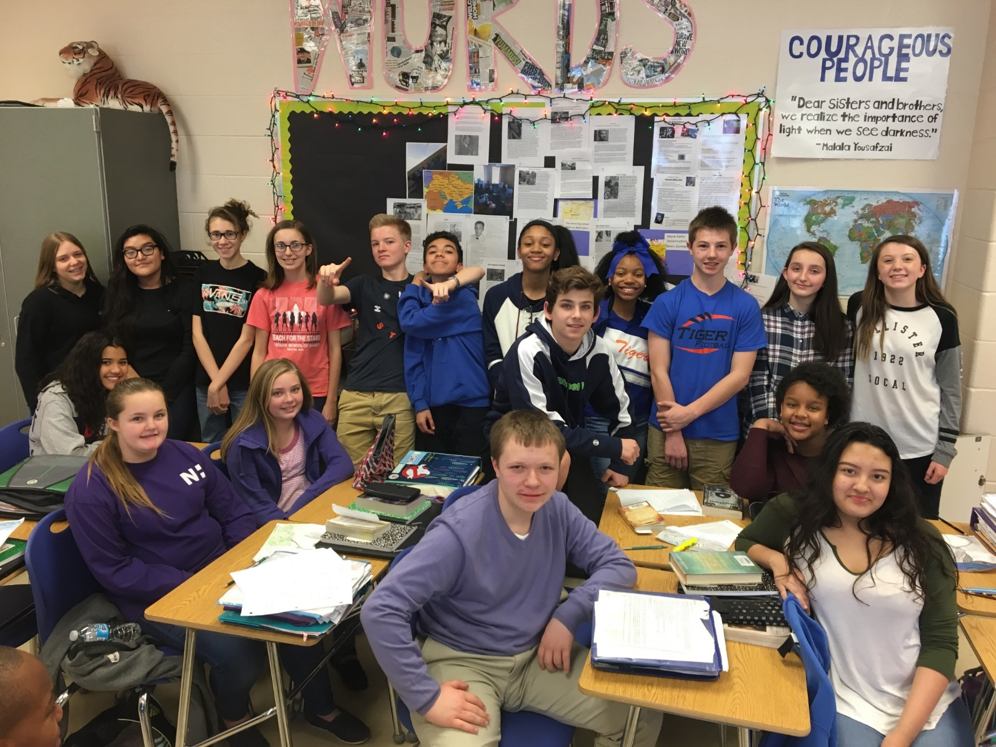

Slide 8
Courageous People Project Extension: Social Movements and Resistance
Brainstorm a list of social movements and acts of resistance. What threads connect these?
What are the characteristics of a social movement? Resistance?
Examine a variety of texts/songs:
“Remaining Awake Through a Great Revolution” – Martin Luther King, Jr.
“Times are a-Changin’” – Bob Dylan
“A Change is Gonna Come” – Sam Cooke
Teacher will provide a list of movements/resistance for student selection.
Through research, students will become the experts and create presentation to share with peers within their class, school and/or other countries.

Slide 9
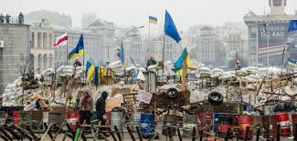
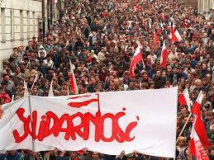
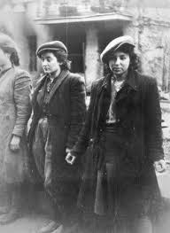
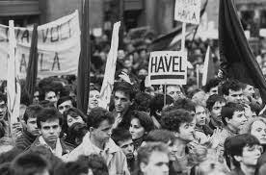
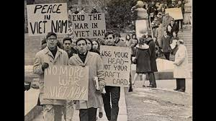
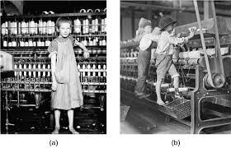
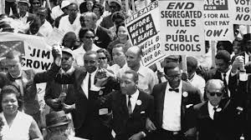
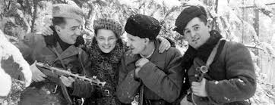
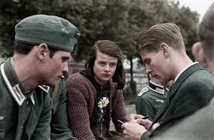
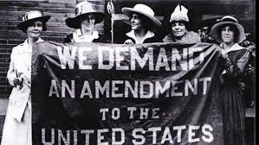
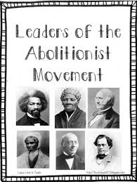
Social Movements and Resistance

Slide 10
A student’s perspective: Kirstyn G.
“…researching the Z.O.B. and actually digging deep with what they did to help had a huge impact on me. First, it taught me how to research and look deeper than the surface. It really made me realize how courageous and bold these young people were. How they impacted our history and changed the world. It really made me think about how much it took for them to do what they did. It made me realize that if you put your mind to it you can really have an impact on the world.”

