Slide 1
The Holocaust Lessons
Siniša Vukadinović

Slide 2
Lesson project - Migrations
Multi-class lesson about the Holocaust
Visit of Israeli students
Exploration of Kaponi/Prica story
The exchange project with German students from Berlin – inspired by Centropa

Slide 3
Migrations - project
Geography lesson “Migrations”
Inspiration for the project – “Return to Rivne“ Centropa film
Discussion after the film with questions
Task 1: At home they had 15 minutes to pack hand luggage bag in case they need to leave their home
They took a photo of what they packed and uploaded it to our Edmodo group
In the school we had discussion about what did they choose and why - (What is important for them)
Task 2: Creation of family migration maps
Students talked with older family members, they collected information and made migration maps and essays
They uploaded family maps and essays to our Edmodo group where we had online discussion (comments)

Slide 4
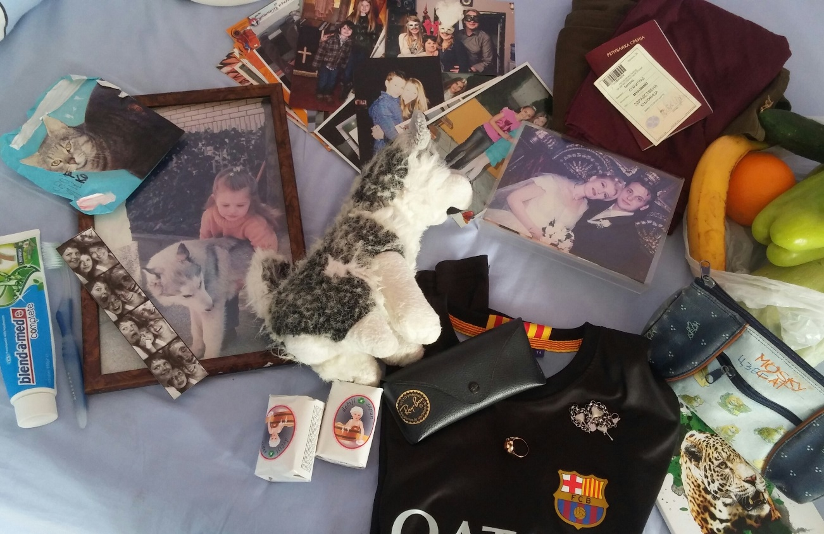
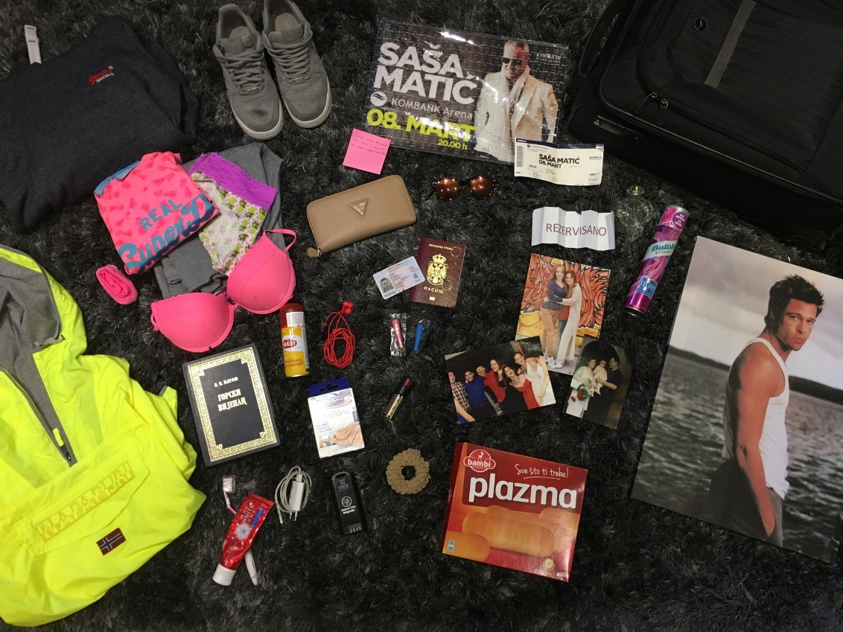
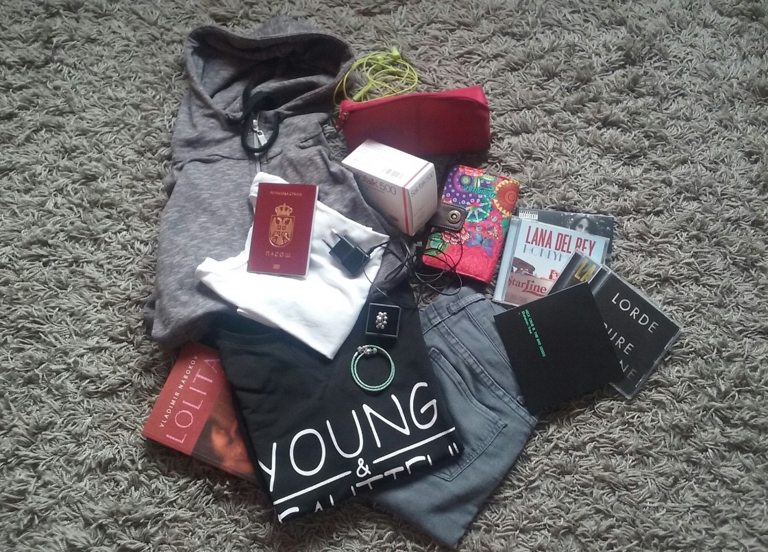
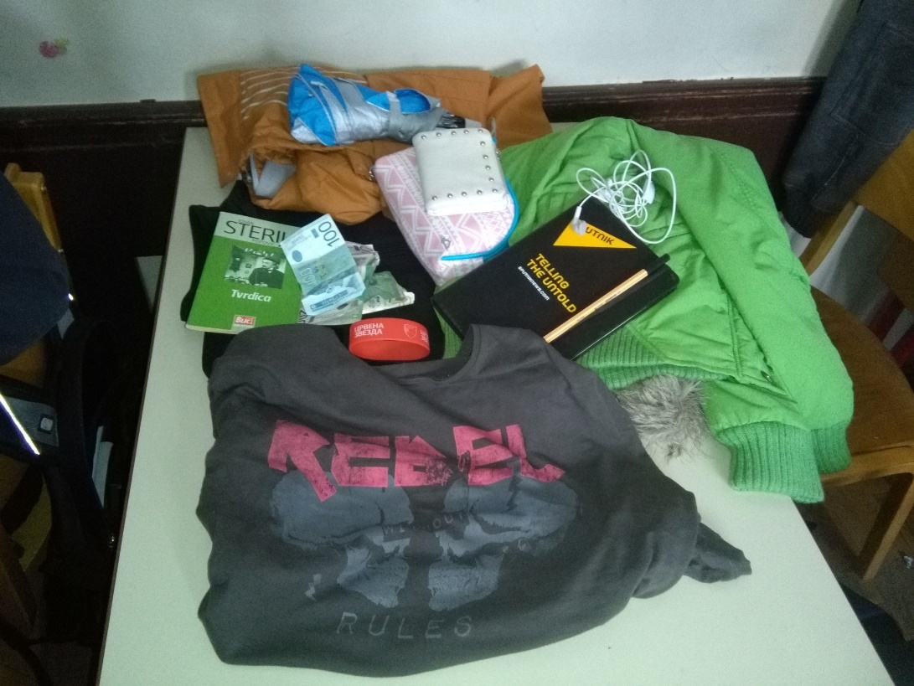

Slide 5
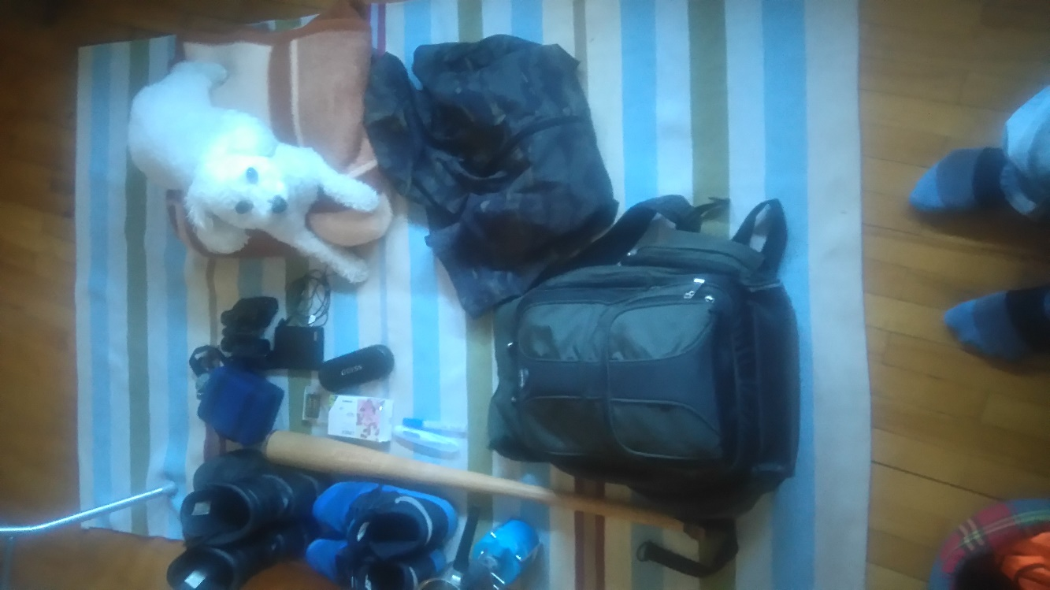
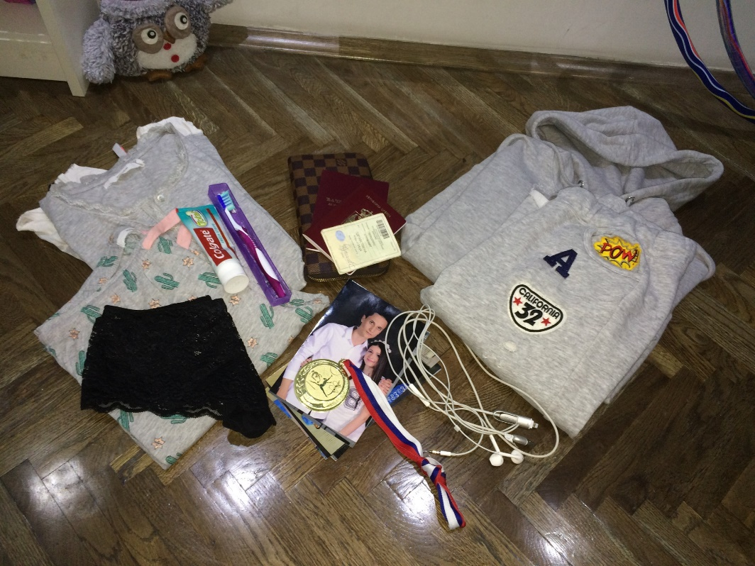
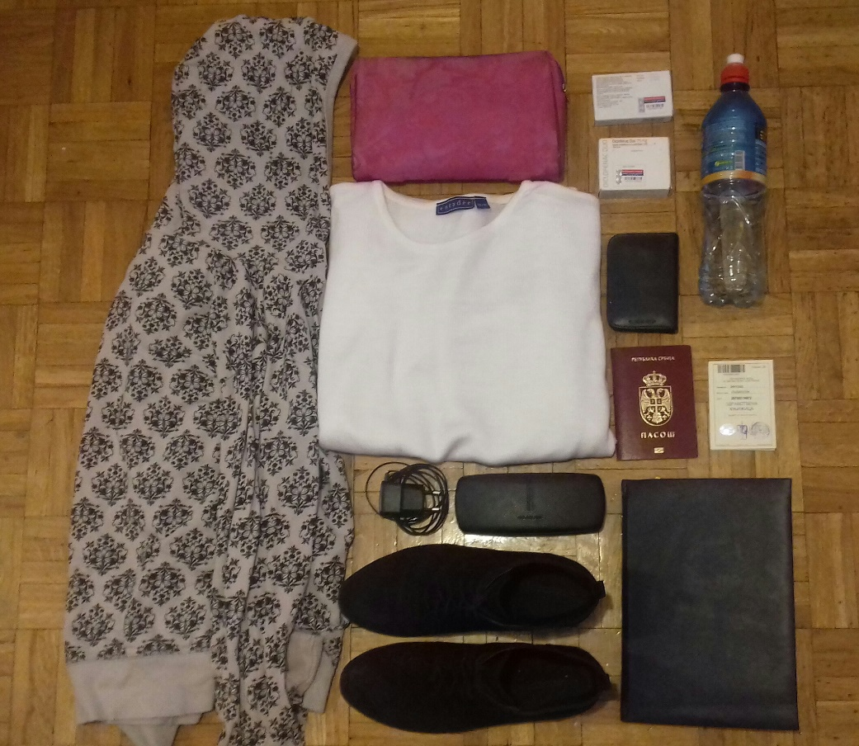
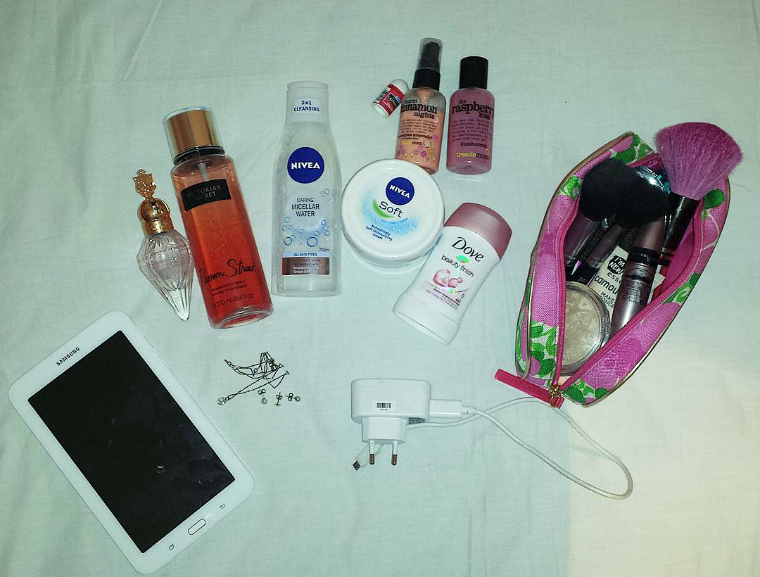

Slide 6
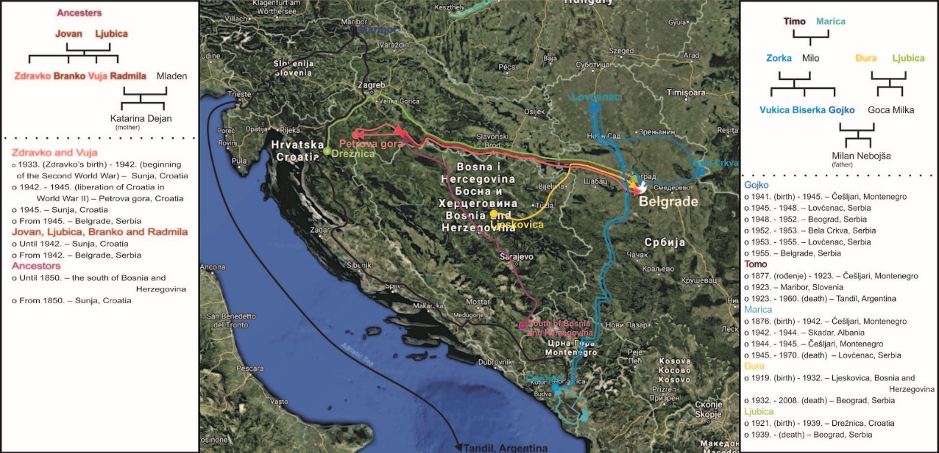
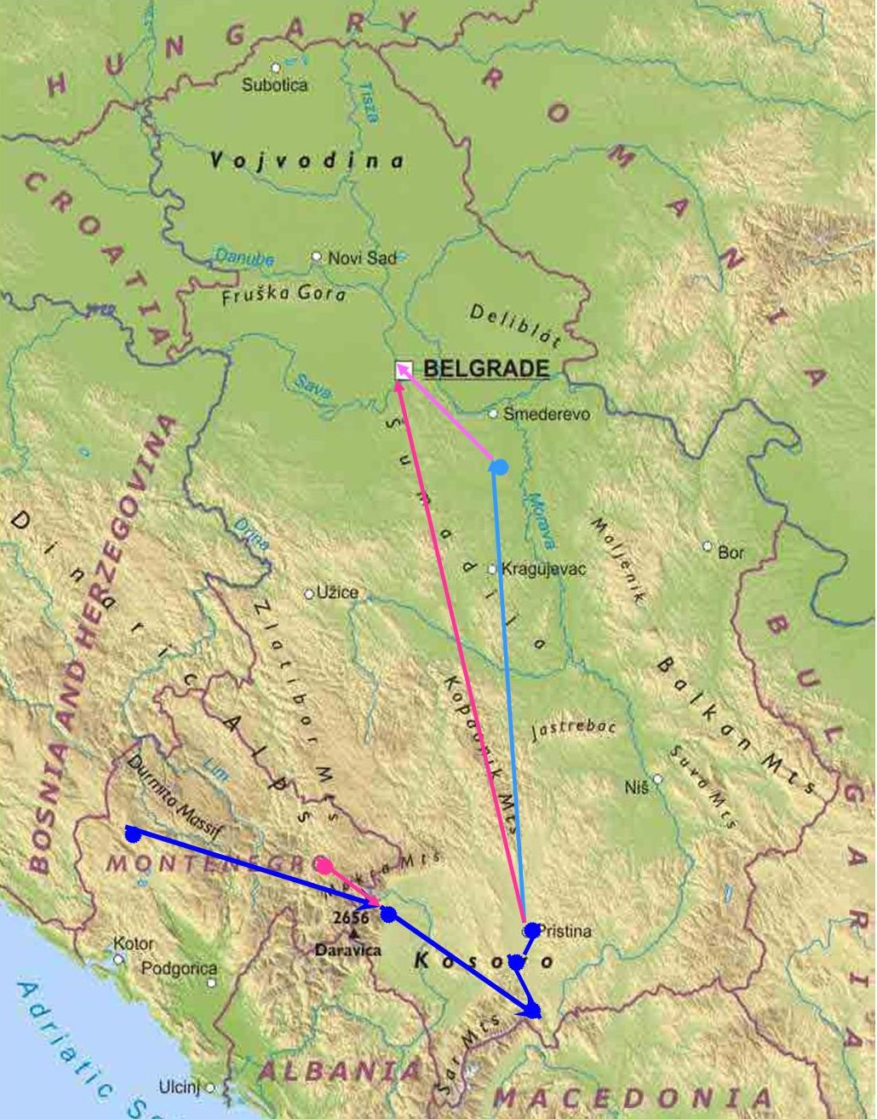
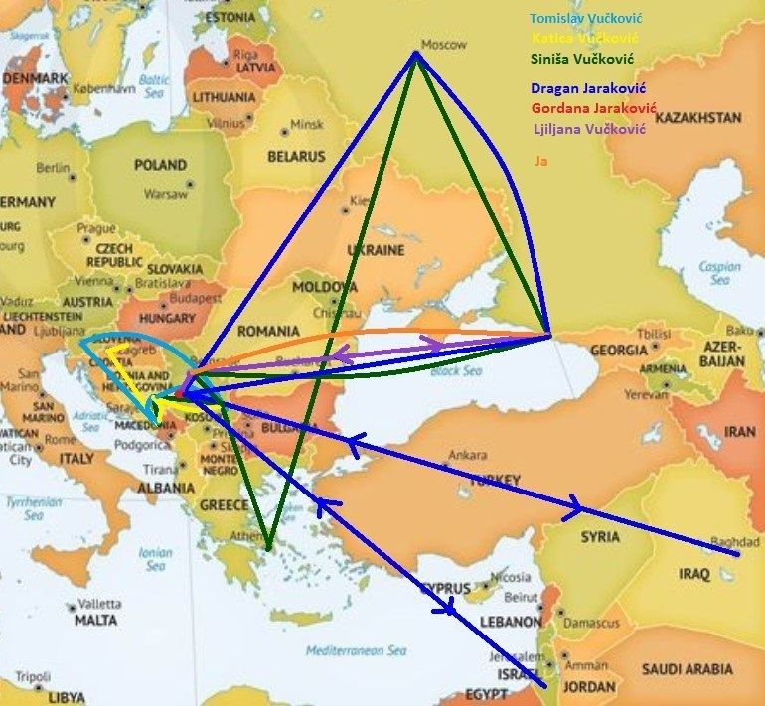
Family migration maps

Slide 7
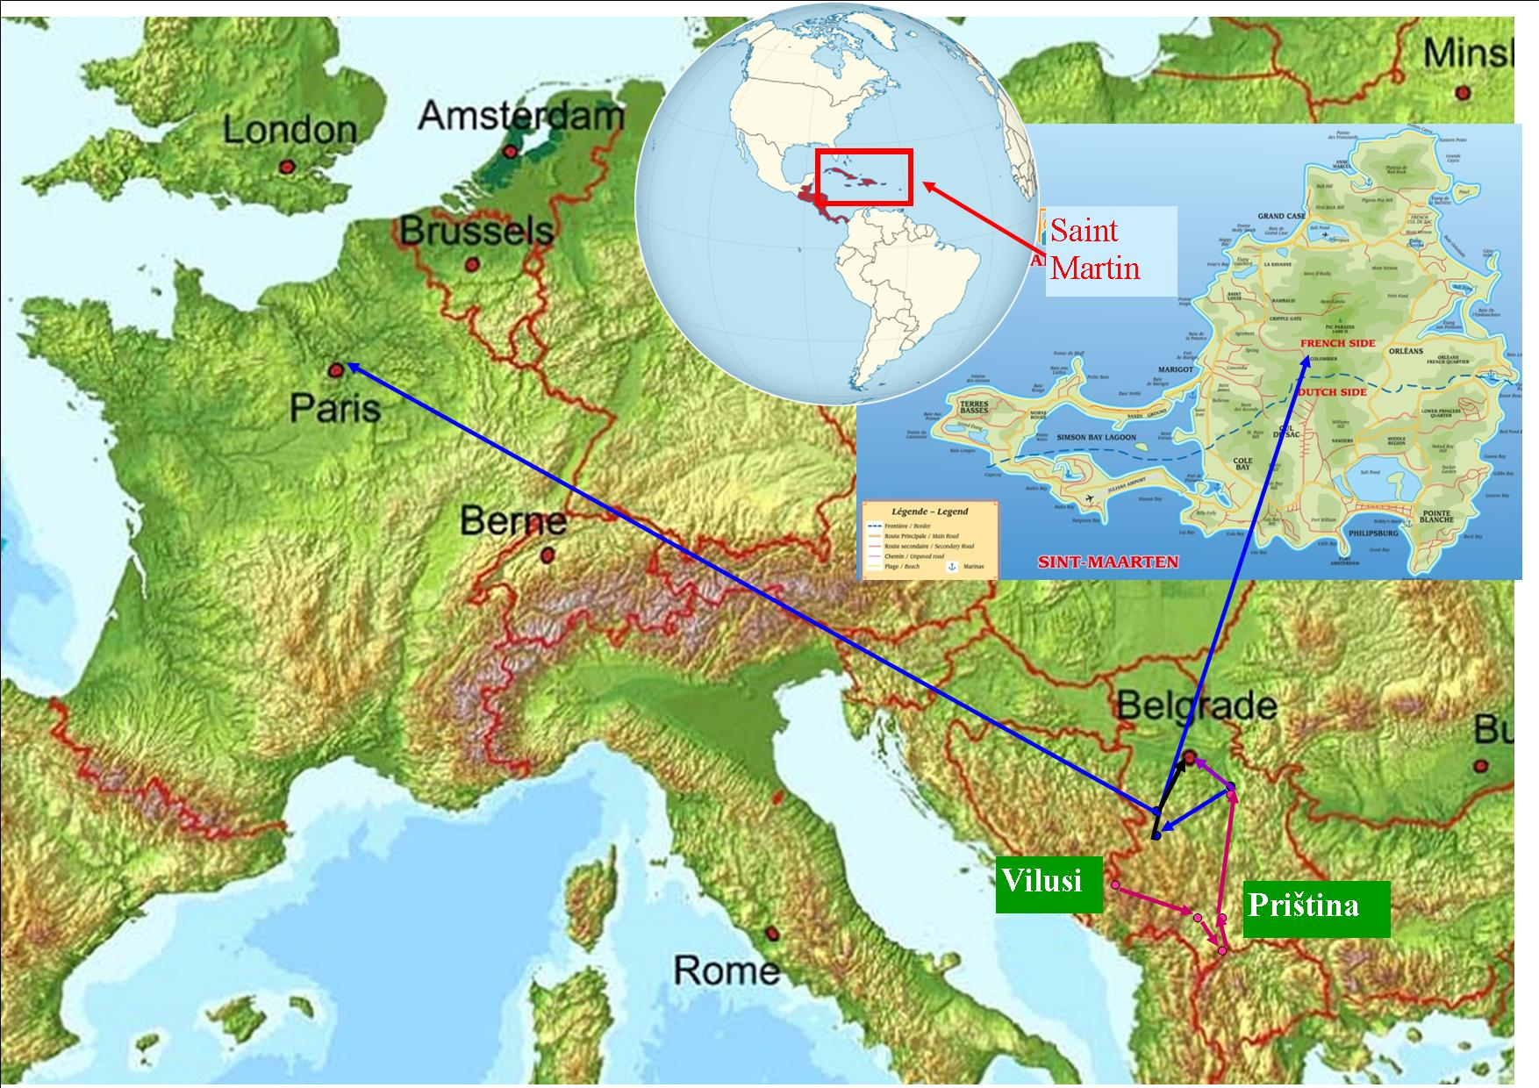

Slide 8
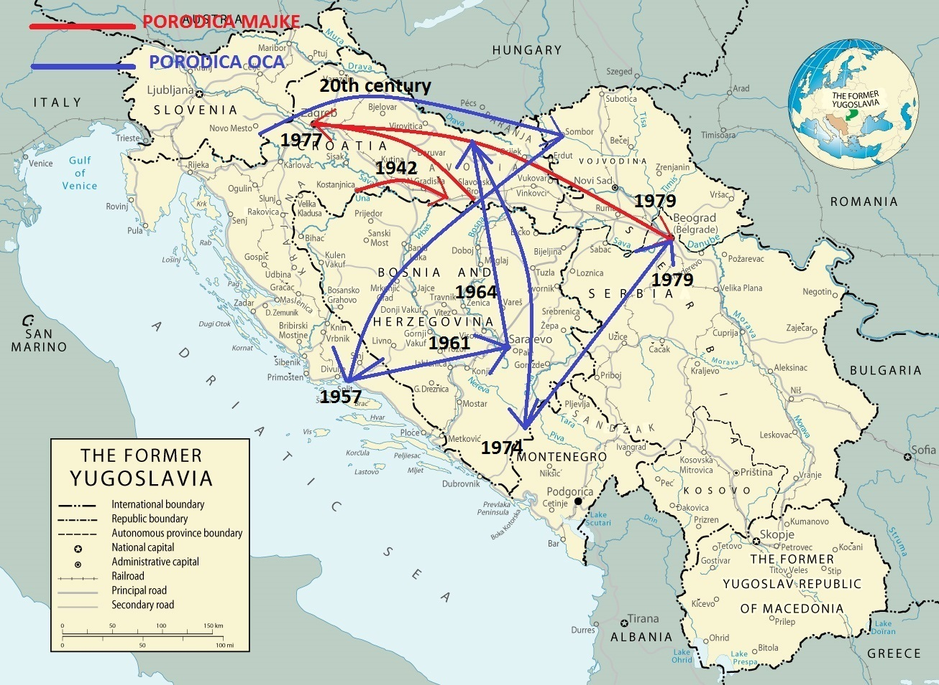

Slide 9
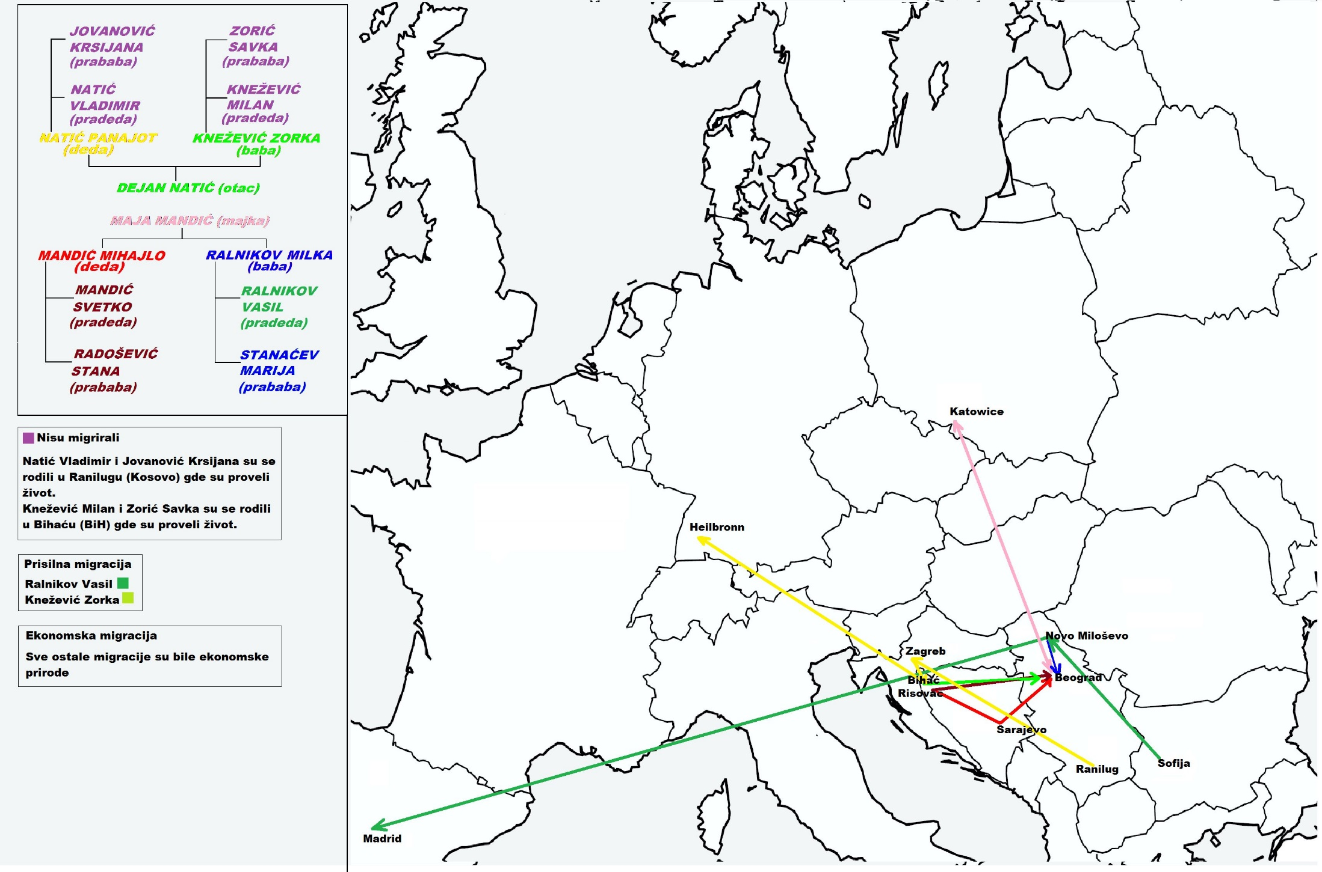

Slide 10
Multi-class lesson about Holocaust
Part one: Life of Jews before war - some students prepare a lecture about life of Jews in Belgrade before the war
Part two: Selected students prepare a life story presentations about Jews who contributed to a diverse range of fields, including the sciences, arts, literature, politics and business. Students know some of them, but majority of them didn't know they were/are Jews (Danilo Kiš, David Albahari, Filip David, Jelisaveta Seka Sablić, Rahela Ferari, Breda Kalef, Lujo Davičo, Mira Adanja Polak, Moša Pijade, Isidor, Bora i Josif Baruh, Geca Kon, Jozef Lapid, Hugo Klajn...)

Slide 11
Part three: We continue with Centropa movie "Three Promises" - students already heard about Kalef family on the previous class. After the movie we analyze the movie with different questions for students.
Before the movie:
What do you remember about Breda Kalef from the previous lesson?
After the movie:
How did you feel while watching the film?
Which character made the strongest impression on you?
Were the promises kept?
Who are the Righteous among the Nations?

Slide 12
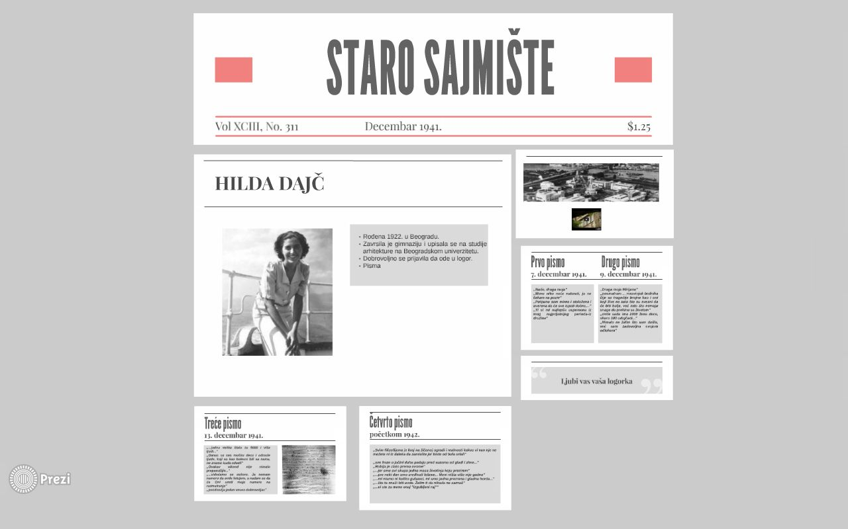
Part four: Jews during the war – Hilda Dajč letters
Example of student’s Prezi presentation

Slide 13
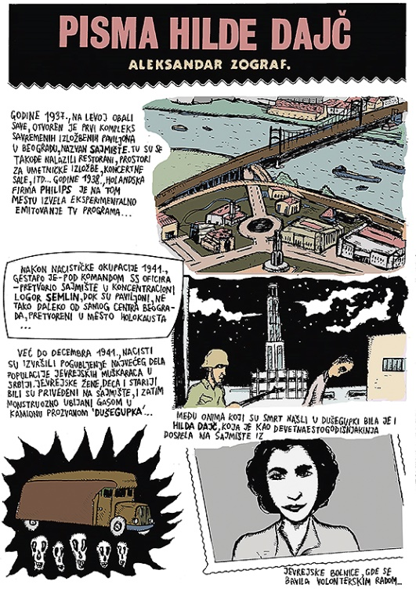
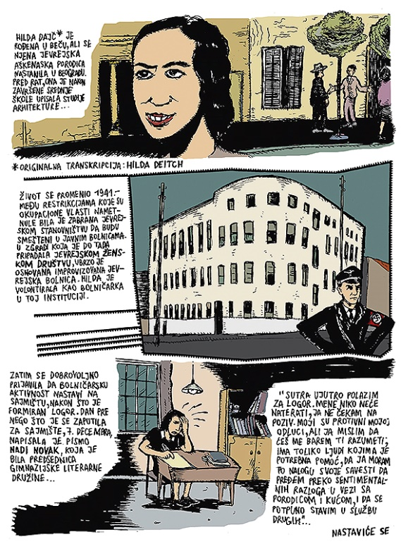
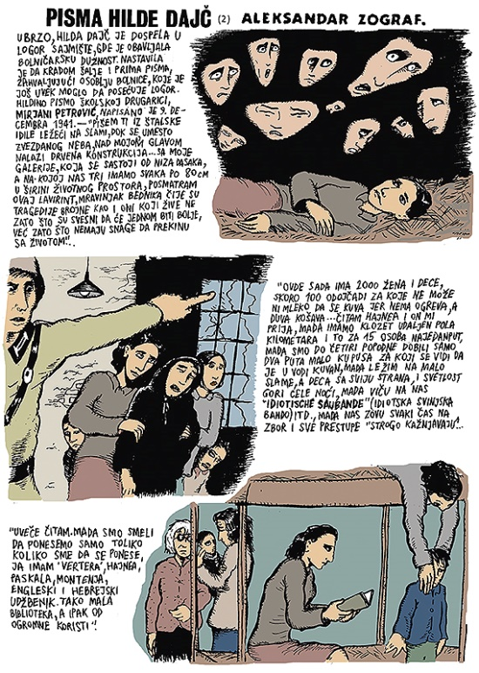
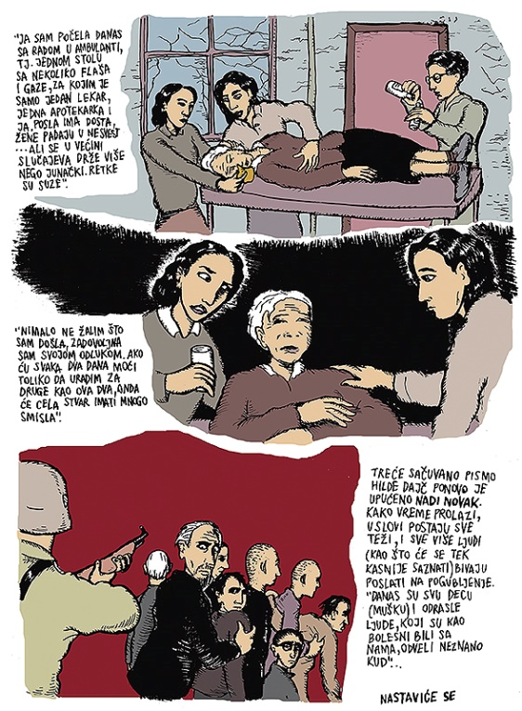
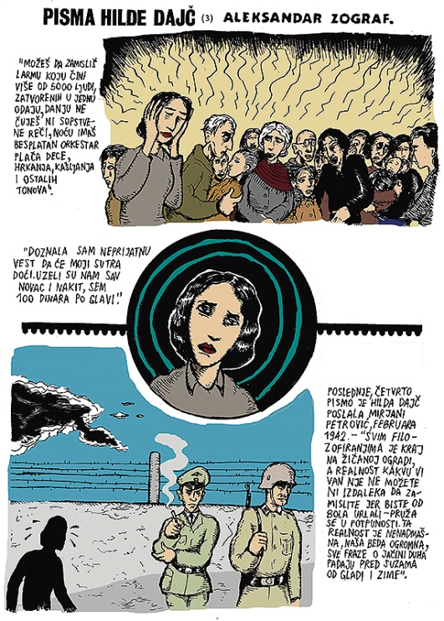
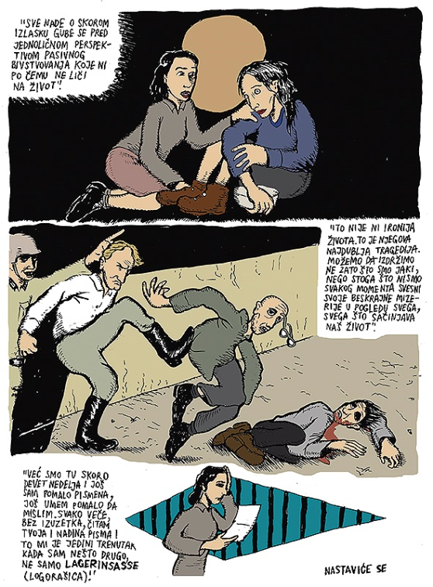
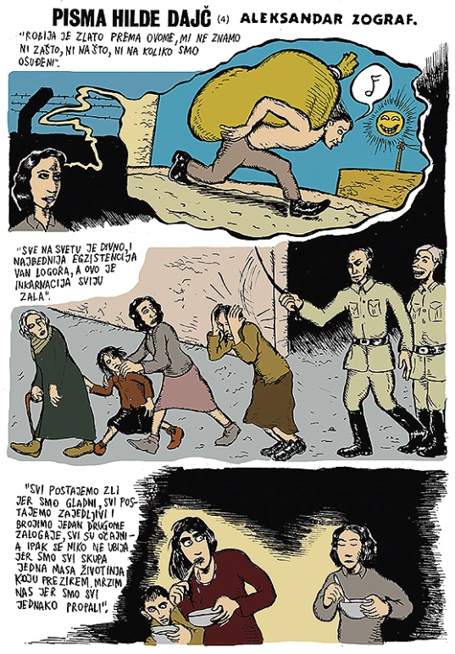
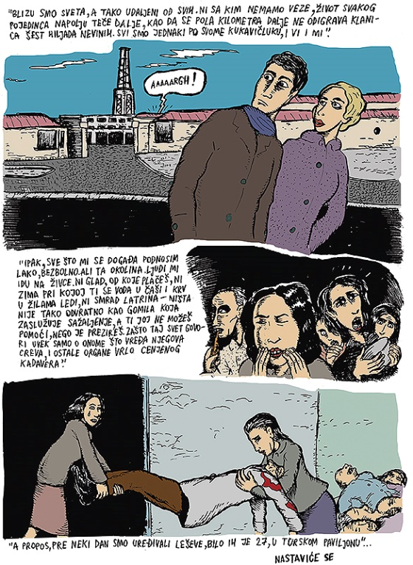
Hilda Dajč letters - Comic book made by Aleksandar Zograf

Slide 14
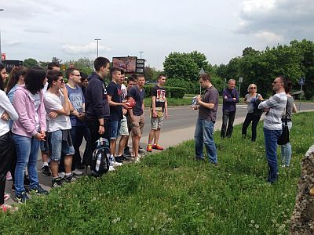
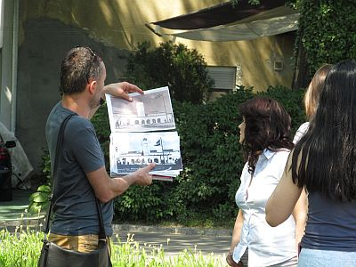
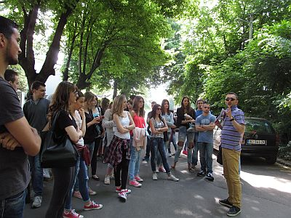
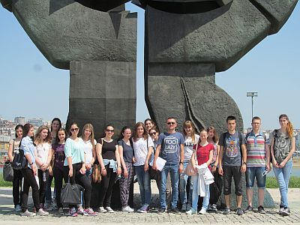
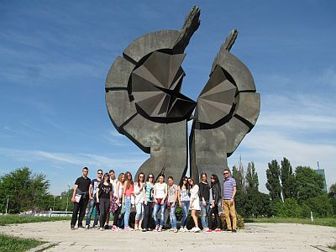
Part five: Lesson on the site of Staro Sajmište, the former concentration camp. I use old photos of each part of the camp, and we have a short lecture about each building in front of the same building now.

Slide 15
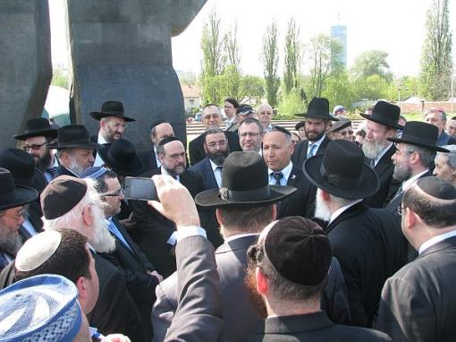
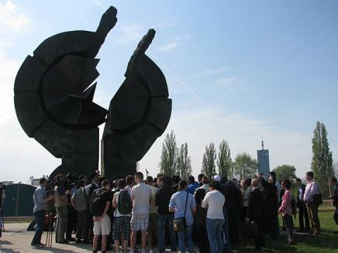
Israeli ambassador Yossef Levy, a group of European rabbis and my students during the visit to Staro sajmište

Slide 16
The visit of Topovske šupe complex
Former military base used as the first concentration camp for Jews, now a private company property
In operation as a concentration camp from August to December 1941
About 4.300 inmates were killed during its operation
In 2013, the owner, Delta Holding, announced plans to demolish the remains of the former camp and build a shopping centre on the site
One of the main contractors behind the project is an architectural group from Israel

Slide 17
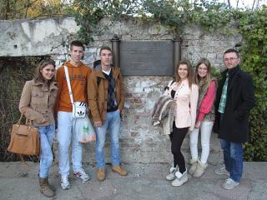
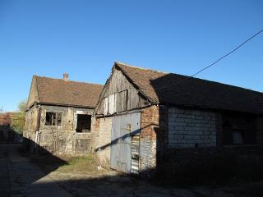
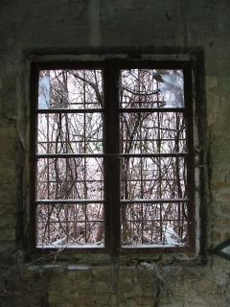
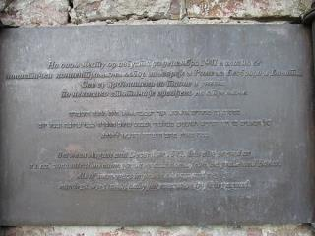
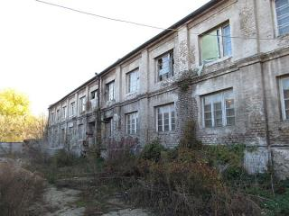

Slide 18
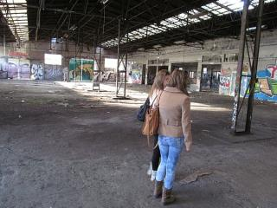
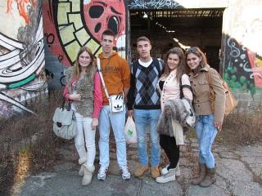
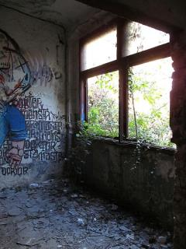
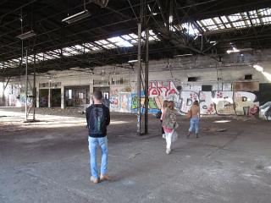
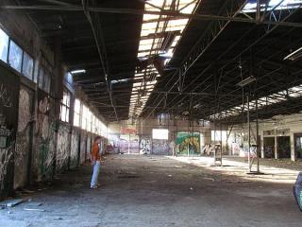

Slide 19
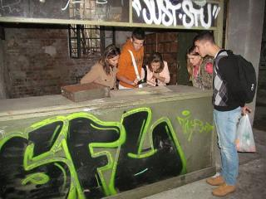
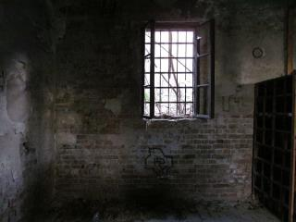
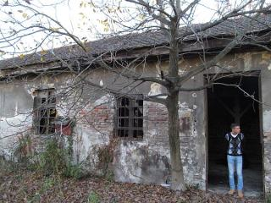
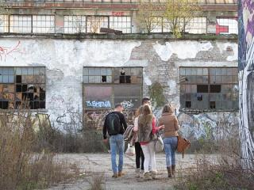
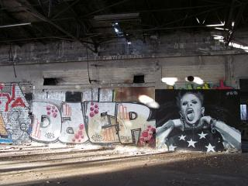
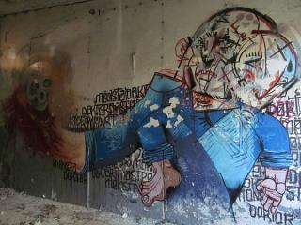

Slide 20
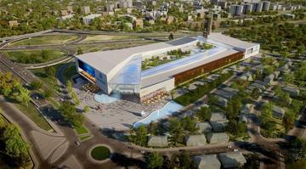
We managed to enter the property of the private company and students explored the entire area
Students were reading testemonies of survivers on the site
After the visit, we had a discusion about our visit and one of the key questions was “Is it morally right to build a shopping centre on a site where people were killed or imprisoned?“

Slide 21
Visit of Israeli students
A group of 40 students and teachers from Young Ambassadors school visited my school this month. Head of the Israeli delegation was Ambassador Yitzhak Eldan, who had a distinguished 41-year career as a diplomat in Israel’s Ministry of Foreign Affairs, including 7 years as the Chief of Protocol and as Israel’s Ambassador to Denmark and UNESCO.
We made workshops together with 60 student from my school and a students’ delegation from Railway Technical school.
After the visit, Israeli students together with me and a group of my students visited Staro Sajmište site where they had a commemoration service.

Slide 22
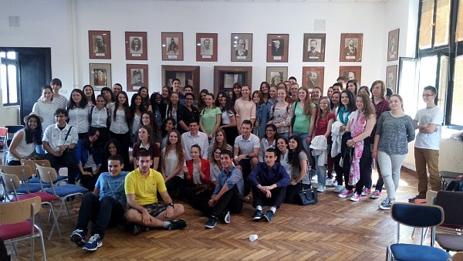
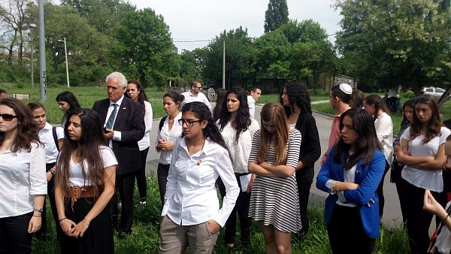
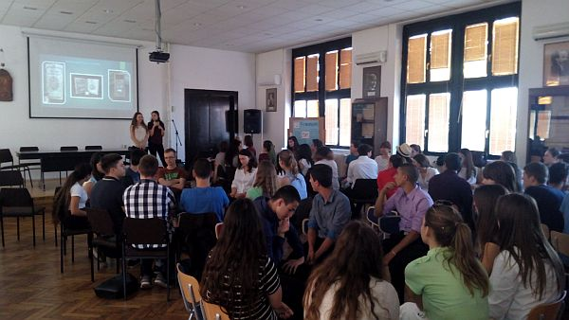

Slide 24
Exploration of Kaponi/Prica story
Idea of making a documentary movie about our former head master, the Righteous among the nations Spasenije Prica and his Jewish student Gershon Kaponi
Made a contact with family of both, Spasenije Prica and Gershon Kaponi (Zoran Šljukić, Olga and Michael Kaponi)
Found a lot of information about it, but still a lot waiting to be explored
Asked Ambassador Yitzhak Eldan for help
Organised a reunion of two families after 74 years

Slide 25
The Righteous Among the Nations Spasenije Prica and his student Gershon Kaponi

Slide 29
List of students fallen in World War II at the school’s entrance

Slide 30
The exchange project with German students from Berlin – inspired by Centropa

Slide 36
The End

